Slide 1

Tanta University
Faculty of Commerce
Business Information System Program Level 4 Web Development Project Hafsa Ahmed Al-Demerdash Zahran Dr.Sara El-Metwally

Slide 2
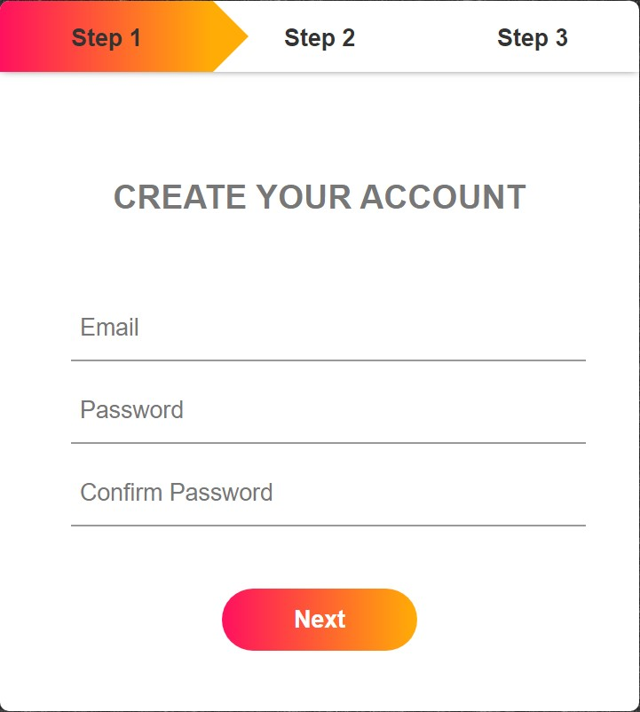
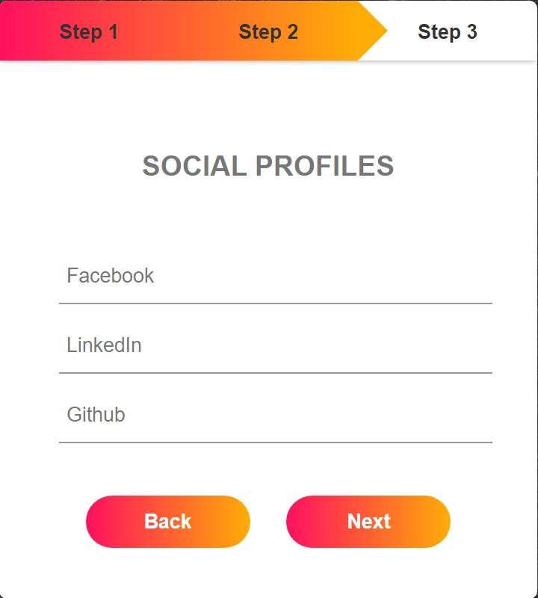
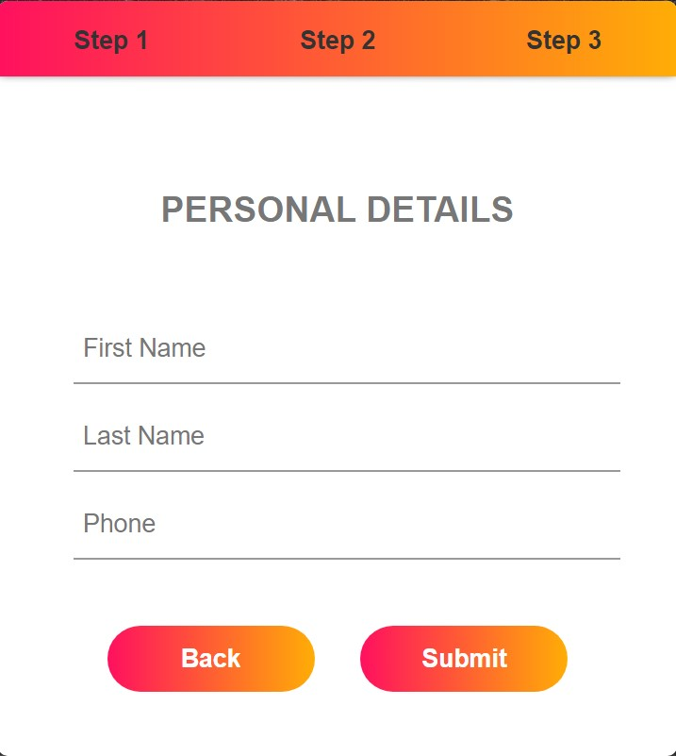
Multiple Step Form using HTML, CSS, and JavaScript

Slide 3

How to collect the most relevant information from customers, while keeping them engaged?

Slide 4


